Slide 1
CORE XT DEMO
Assignment
SABKA BAZAAR (Shopping Cart)

Slide 2
Requirements
This is a shopping cart demo site, with cart functionality having 5 pages, that all pages are responsive for mobile , tablet and desktop.
Home
Product Listing Page
Signin
Register
Cart

Slide 3
NFR’s
Mobile First Approach
Single Page Application
Linting
Accessibility
ES 6
BEM Model
SCSS
HBS

Slide 4
Tech Specs
HTML
HTML 5 Semantic Elements
Html Structure For Web Accessibility
Avoiding unnecessary tags
CSS
Used SCSS
Mobile First Approach.
Class name according to BEM.
Nesting in BEM upto 3 levels.

Slide 5
JAVASCRIPT
MVC Structure
ES6
Session Storage
Single Page Application Approach
HANDLEBAR
This use to divide a big task or page into smaller components so that components can be reused. In this we can also manipulate the dynamic data rendering.
Used Two Folders for this
Templates
To get hbs files which will work with dynamic data coming from server
Partials
These are static pages for Single Page Application (SPA)

Slide 6
NODEJS
APIs
GET products : ‘/products’
GET products by category id : ‘/products?categoryId={categoryId}’
GET categories : ‘/categories’
GET Home Banners : ‘/home_banners’
MONGODB
DB (Shopping Cart)
Collections
category
home_banners
products

Slide 7
WEBPACK
Bable
Scss to css
Karma jasmine test cases
Karma Jasmine (Test Cases)

Slide 8
Directory Structure
Shopping Cart
Src
Js
Partials
Templates
Sass
Index.html
Public
Static (All Images)
Bundle.js
Style.css
index.html
Test
Test.spec.js
Node-index.js (Node JS)
Connection.js (Mongo Connection )

Slide 9
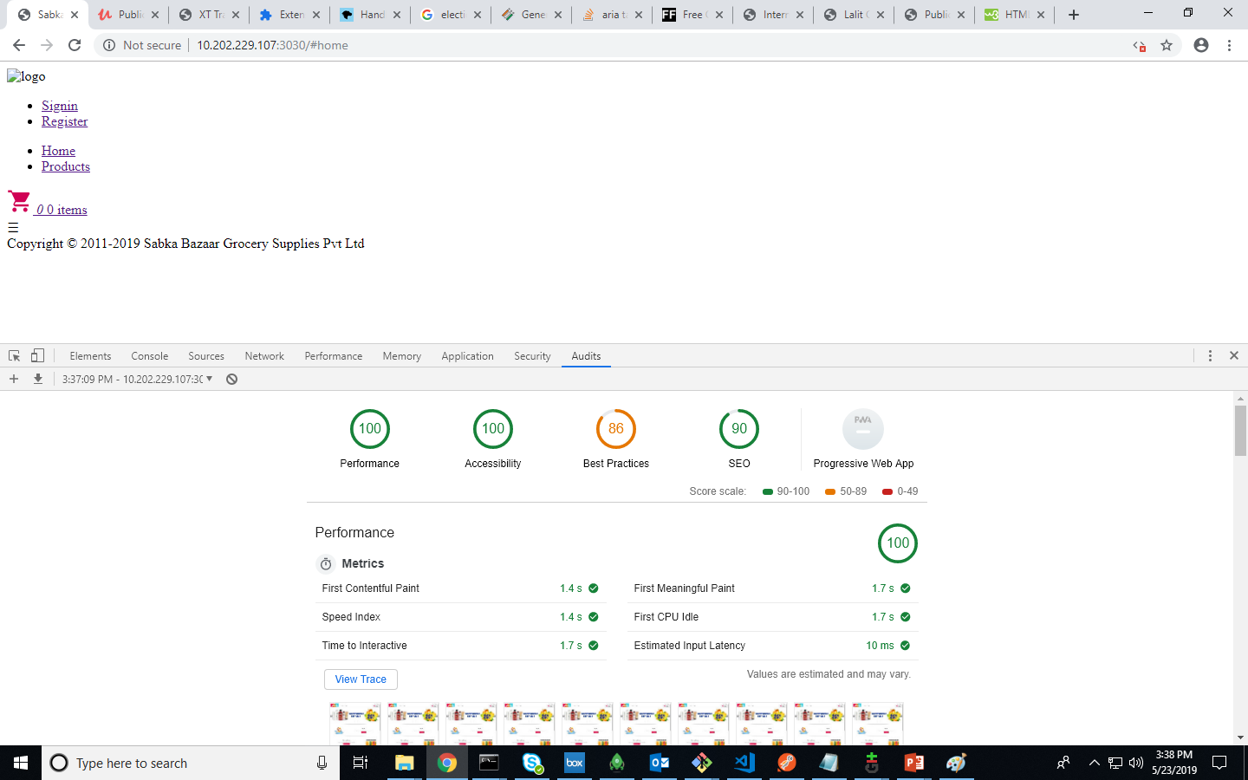
Audit Report

Slide 10
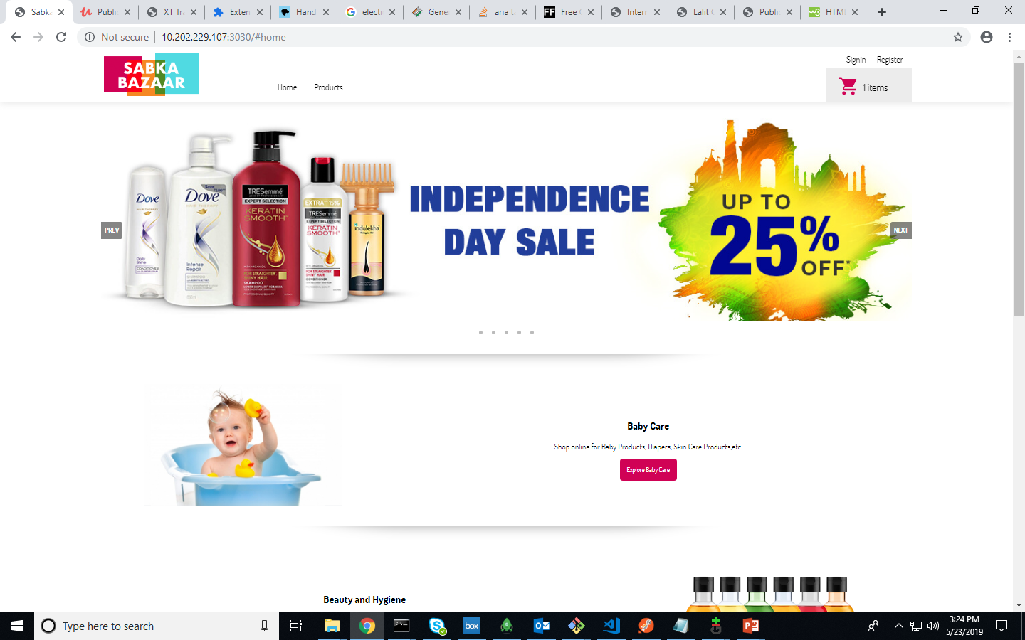
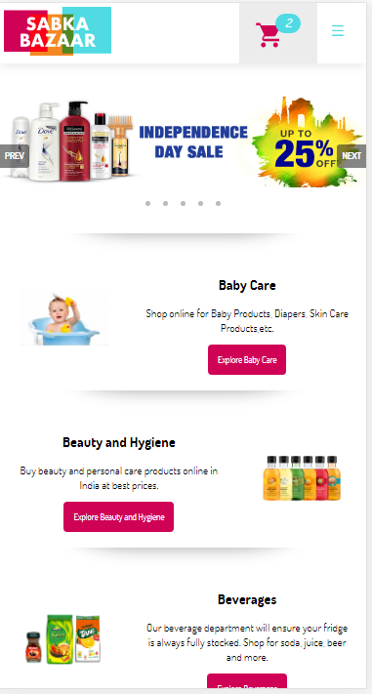
Home Page

Slide 11
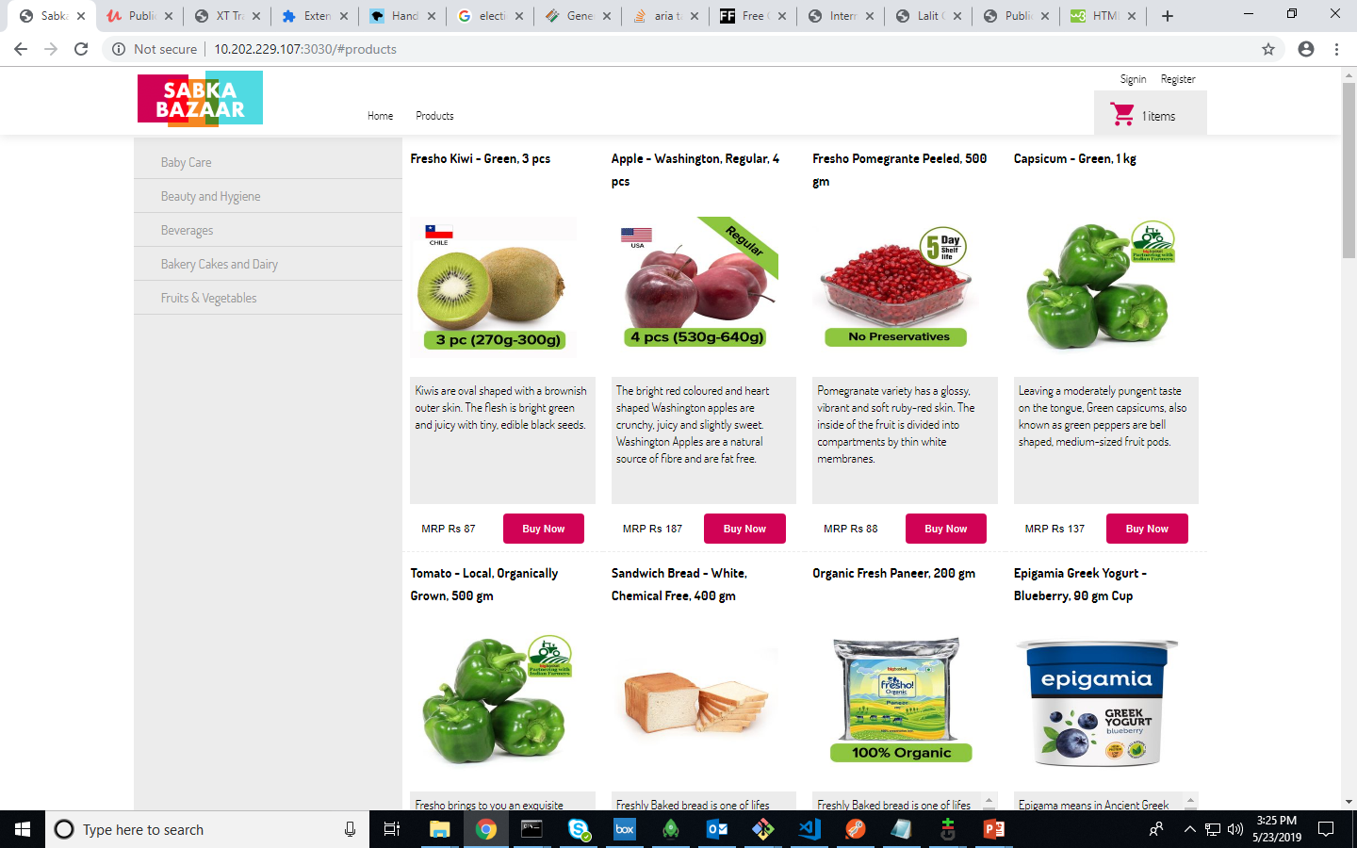
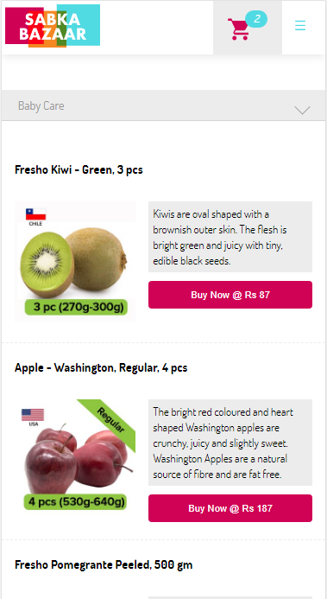
PLP

Slide 12
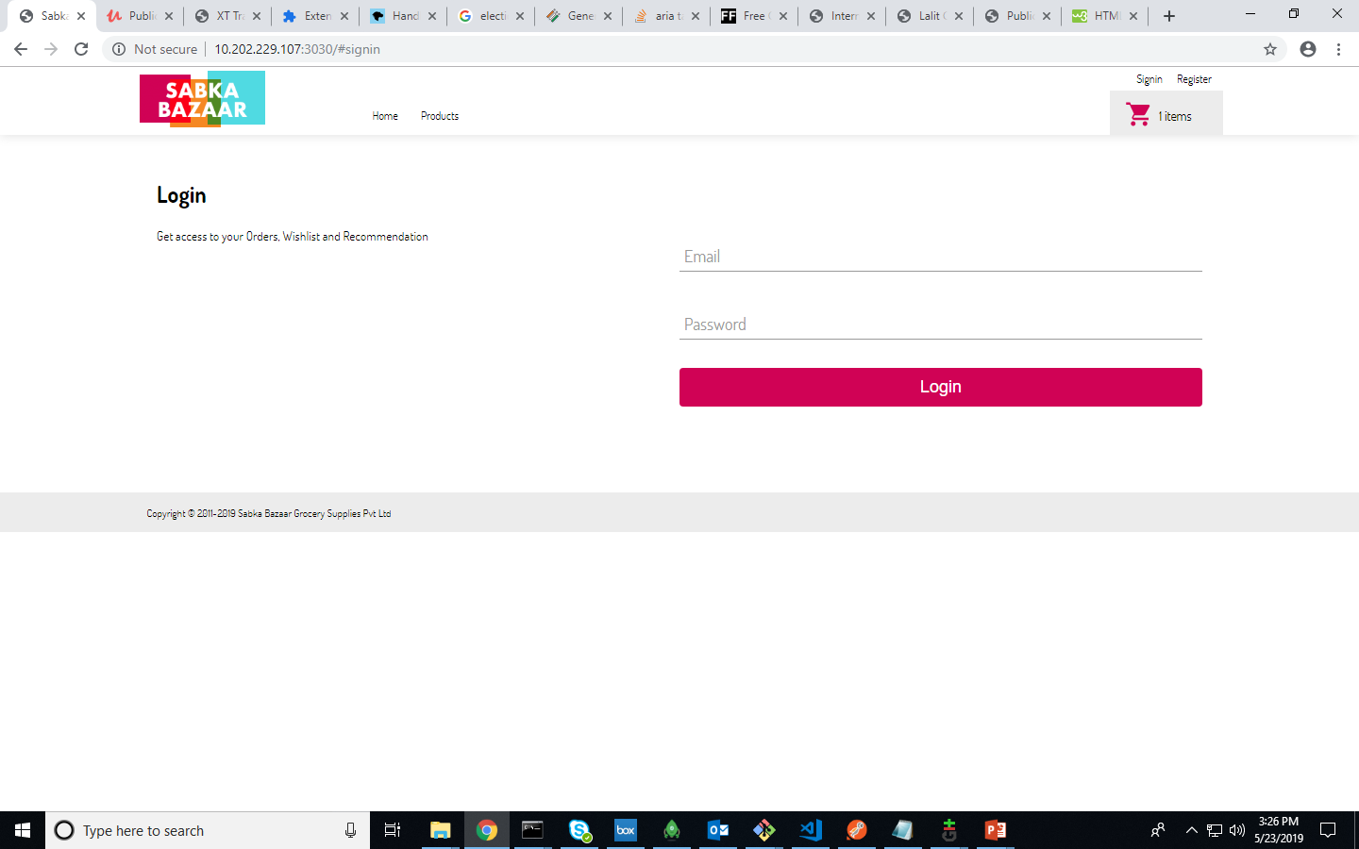
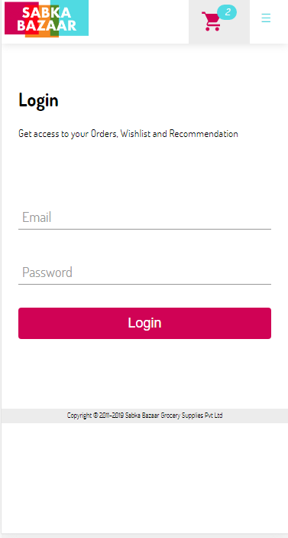
Signin

Slide 13
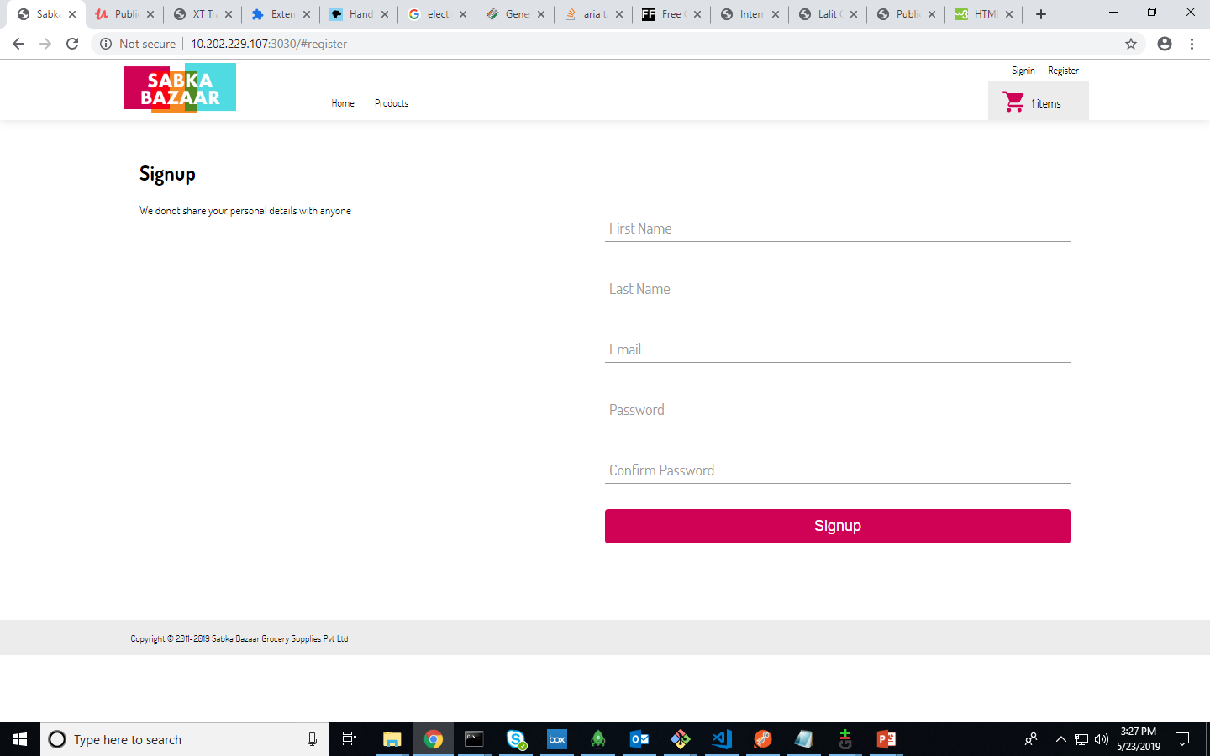
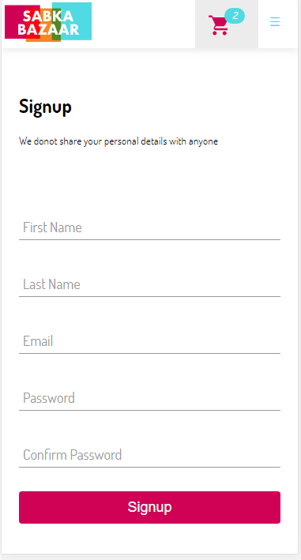
Register

Slide 14
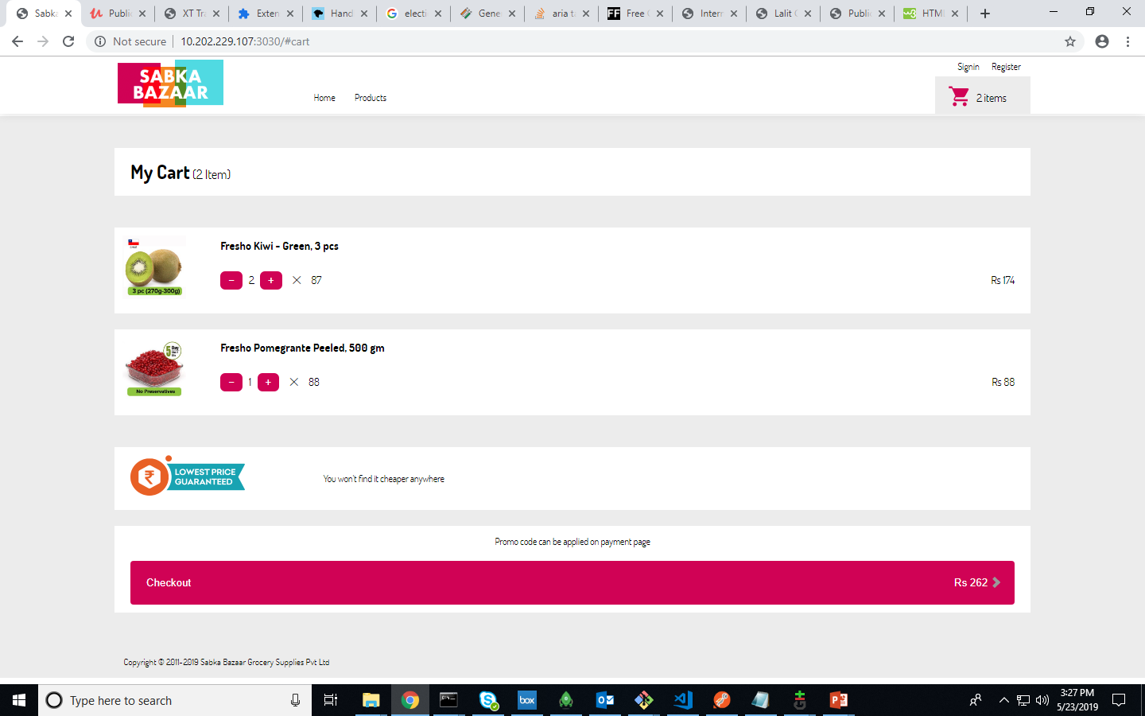
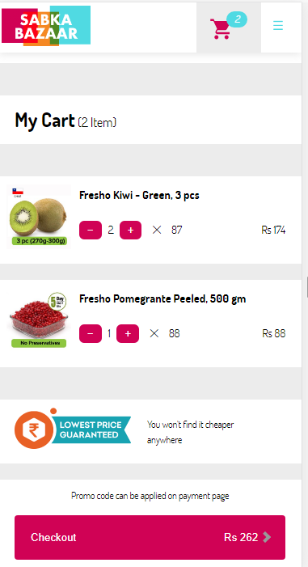
Cart

Slide 15
Thanks Lalit Chaudhary

